Slide 1
U-46 Funding – Data Pertinent for ETA Members

Slide 2
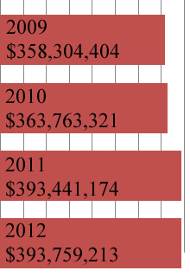
District Revenue
Receipts/Revenues for Operations
(includes the Educational, Operations & Maintenance, Transportation, and Working Cash funds)
The district revenue has increased by approximately 9% from 2009 to 2012.
Data from annual financial reports submitted to ISBE
from U-46. (Financial Profile page 3, D16)

Slide 3
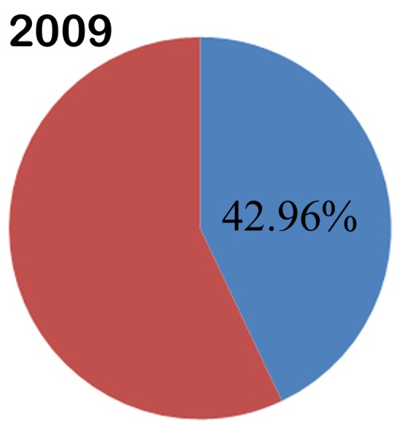
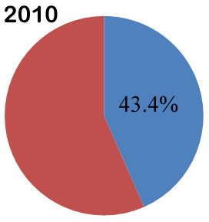
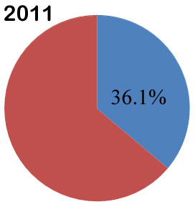
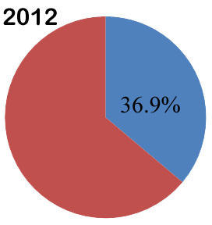
Percentage of total revenues allocated for instructional employee salaries
Data from annual financial reports submitted to ISBE from U-46. (Financial Profile Expenditures, D16, minus Expenditures 15-22, D32)

Slide 4
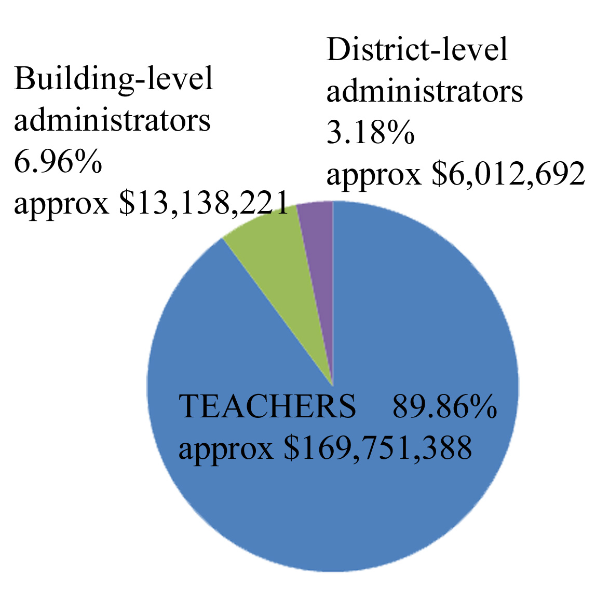
How Much Goes to Administrators?
Total Amount Spent on Teacher and Administrator Salaries (including benefits and retirement incentives) for the school year ending 2013 = $188,902,301
Data EIS Administrator and Teacher Salary and Benefits Report – School Year 2013, found on the U-46 website

Slide 5
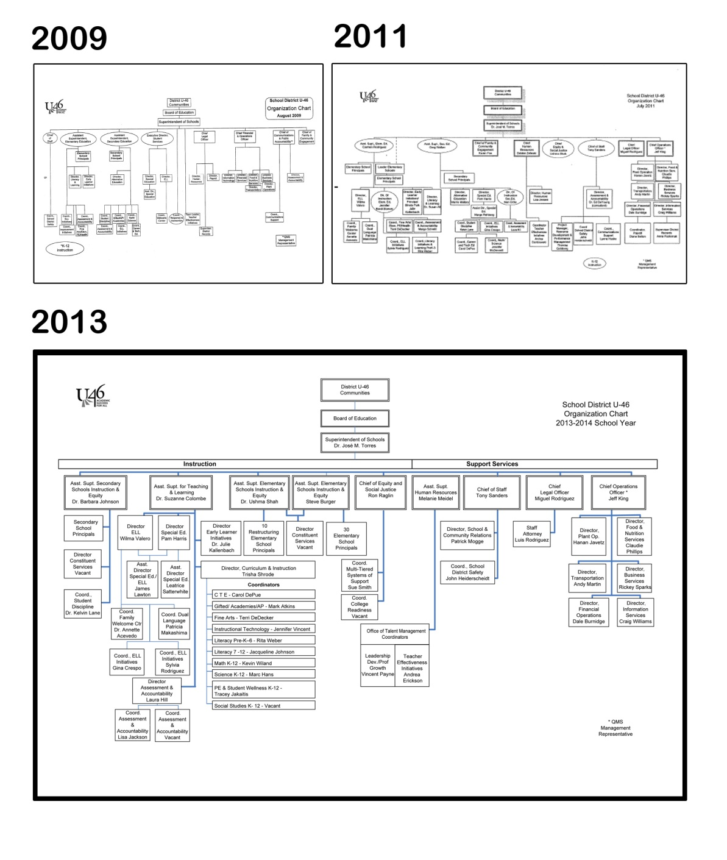
Changes to the organizational chart
COMMUNITY PERSPECTIVE
“Administrative salaries have increased by 21 percent - 3.7 million - since fiscal year 2011.”
-- Rick Newton, Wayne Reident, quotes in “U-46 Proposed Budget for 2014 Draws Criticism” –Daily Herald, Sept. 16, 2013

Slide 6
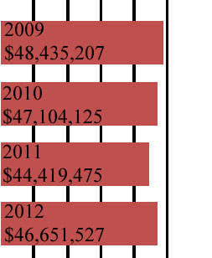
District contributions to employee benefits
From 2009 to 2012, the district contribution to employee benefits for instructional positions has fluctuated by approximately .1%
Figures include benefits for all U-46 instructional employees (not just teachers and administrators)
Data from annual financial reports submitted to ISBE
from U-46. (Expenditures 15-22, D32)

Slide 7
Other Specific Places with Questionable Spending
U-46 paying non-ETA members for jobs like APEX evaluation and RTI training
Should these jobs be held by ETA members?
U-46 investing in instructional programs (computer programs, consultants, etc.) without the support of the ETA members who will be affected
Should ETA members have more input in how money for instructional programs is invested?

Slide 8
All ETA Members
E-mail a member of the compensation committee if you can suggest a specific place where the district ineffectively uses funds.
Compensation committee members:
Susan Collins
Jackie Jagielski
Jeff Horler
Erin Kolak
Barkley Mapes
Martin Potts

Slide 9
ETA Reps!
Please consider presenting this PowerPoint during the ETA time during your next staff meeting.
If you cannot present this information, please distribute the slides to ETA members at your school.

