Slide 1
Guideline
3. Grade scales should be devised to give equal incremental value to each letter grade.

Slide 2
Rationale
To not over penalize students for failing an assignment.
The inequity of using a traditional 100 point scale with an E being 0-59.

Slide 3
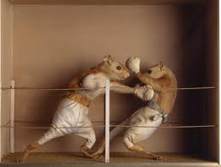
Scales
Current U-46 Scales
100-90 A
89-80 B
79-70 C
69-60 D
59-0 E
2013-2014 Scale
100-90 A
89-80 B
79-70 C
69-60 D
59-50 E
2013-2014 Scale
5 A+ (100%)
4 A (90%)
3 B (80%)
2 C (70%)
1 D (60%)
0 E anything 59%
or below
You will still enter points in Infinite Campus for your assignments.

Slide 4
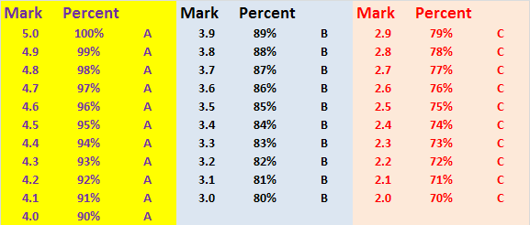
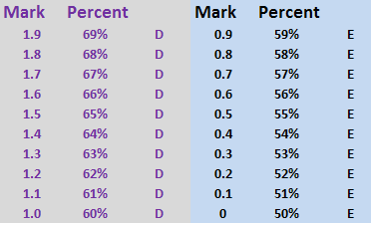
A side by side look at the two grading scales.

Slide 5
Assignments | Student Score | Possible points | 0-100% scale (currently used) | 50%-100% scale | 5 point scale
homework 1 | 10 | 10 | 100% | 100% | 5
homework 2 | 4 | 10 | 40% | 50% | 0
quiz 1 | 20 | 25 | 80% | 80% | 3
homework 3 | 7 | 10 | 70% | 70% | 2
lab 1 | 35 | 40 | 88% | 88% | 3.8
test 1 | 75 | 100 | 75% | 75% | 2.5
homework 4 | 10 | 10 | 100% | 100% | 5
homework 5 | 1 | 10 | 10% | 50% | 0
lab 2 | 30 | 40 | 75% | 75% | 2.5
quiz 2 | 18 | 25 | 72% | 72% | 2.2
lab 3 | 38 | 40 | 95% | 95% | 4.5
test 2 | 85 | 100 | 85% | 85% | 3.5
 |  | final grade = | 79% of total pts 74% ave % | 78% ave 5 | 2.8
 |  | letter grade | C | C | C
Notes:
Total point scale—your average student

Slide 6
Assignments | Student Score | Possible points | 0-100% scale (currently used) | 50%-100% scale | 5 point scale
homework 1 | 10 | 10 | 100% | 100% | 5
homework 2 | 10 | 10 | 100% | 100% | 5
quiz 1 | 20 | 25 | 80% | 80% | 3
homework 3 | 10 | 10 | 100% | 100% | 5
lab 1 | 35 | 40 | 88% | 88% | 3.8
test 1 | 75 | 100 | 75% | 75% | 2.5
homework 4 | 10 | 10 | 100% | 100% | 5
homework 5 | 1 | 10 | 10% | 50% | 0
lab 2 | 35 | 40 | 88% | 88% | 3.8
quiz 2 | 23 | 25 | 92% | 92% | 4.2
lab 3 | 38 | 40 | 95% | 95% | 4.5
test 2 | 85 | 100 | 85% | 85% | 3.5
 |  | final grade = | 83.8% of total pts 84.3% ave % | 87.7% ave % | 3.7
 |  | letter grade | B | B | B

Slide 7
Reflection
These grading scales will not overly inflate earned grades.
Allows students who make one or two mistakes to not be overly penalized.

Slide 8
Assignments | Student Score | Possible points | 0-100% scale (currently used) | 50%-100% scale | 5 point scale
homework 1 | 5 | 10 | 50% | 50% | 0
homework 2 | 2 | 10 | 20% | 50% | 0
quiz 1 | 2 | 25 | 8% | 50% | 0
homework 3 | 8 | 10 | 80% | 80% | 3
lab 1 | 0 | 40 | 0% | 50% | 0
test 1 | 35 | 100 | 35% | 50% | 0
homework 4 | 5 | 10 | 50% | 50% | 0
homework 5 | 2 | 10 | 20% | 50% | 0
lab 2 | 5 | 40 | 13% | 50% | 0
quiz 2 | 10 | 25 | 40% | 50% | 0
lab 3 | 0 | 40 | 0% | 50% | 0
test 2 | 20 | 100 | 20% | 50% | 0
 |  | final grade = | 22.3% of total pts, 28.0% average % | 52.5% ave % | 0.25
 |  | letter grade | E | E | E
Notes:
The failing student

Slide 9
Reflection
If this represents half of the grading period, the last slide represents a student who has a chance to recover from poor choices. With a 52.5% in half of the expected work, the student could still earn credit for the class if he completes assignments and does well.
With the student with 28%, that student will simply give up. There is minimal chance of earning credit for the class.

